Slide 1
Master Reports for IMAs

Slide 2
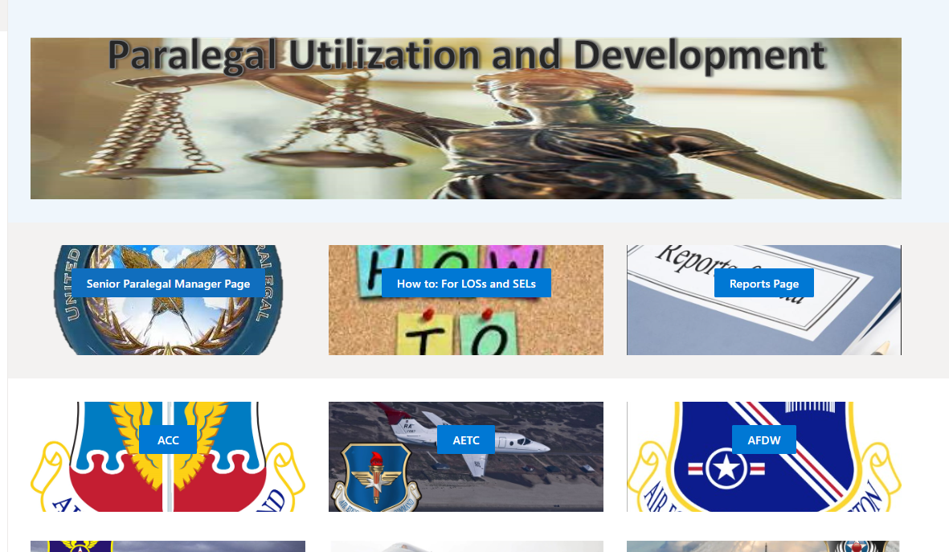
If you are within the SPM Managers group you can go to the SPM Page to pull excel documents.

Slide 3
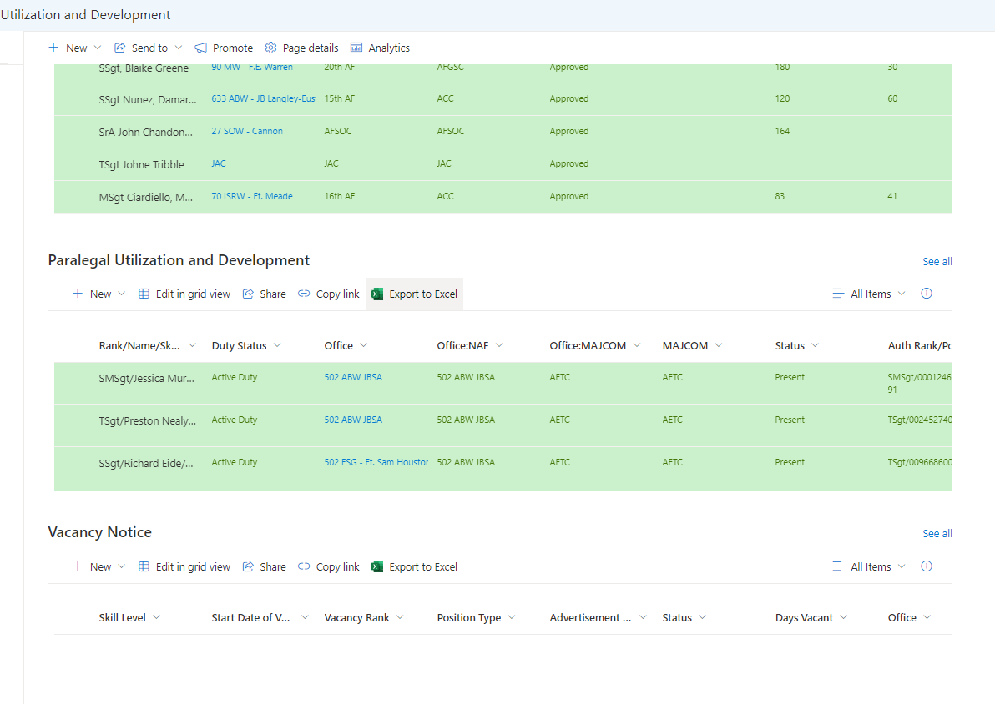
Find the list where you want to pull data from and click the Export to Excel button.

Slide 4
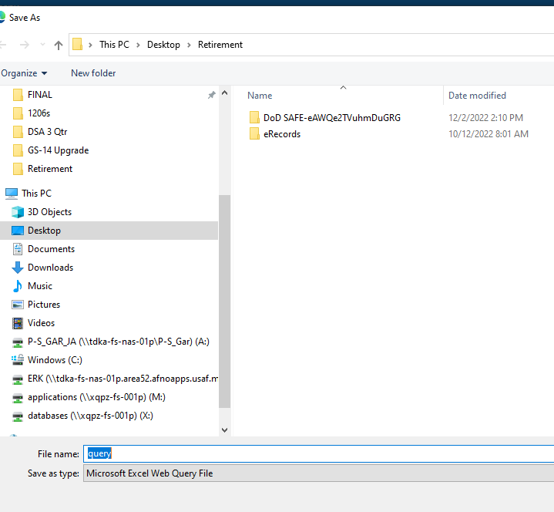
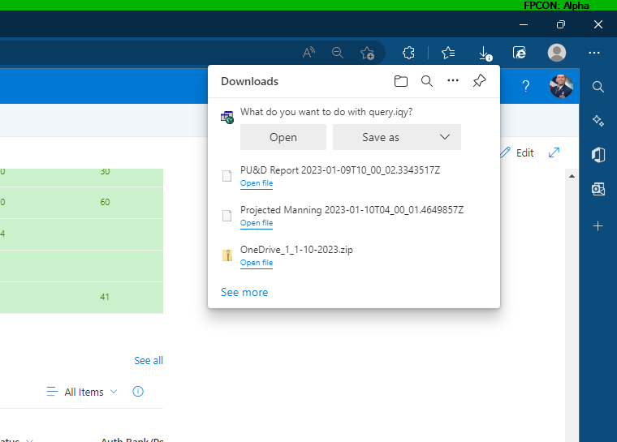
Tell it to save as and save it in a good location and update the name if needed. However keep the file type to the one shown.

Slide 5
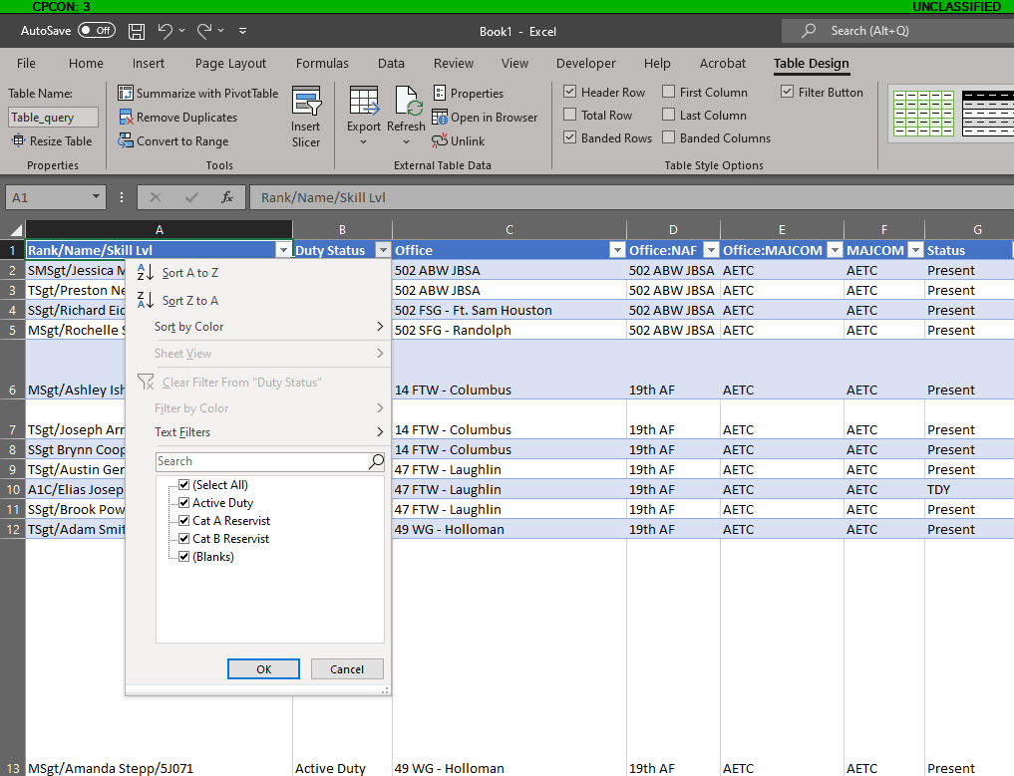
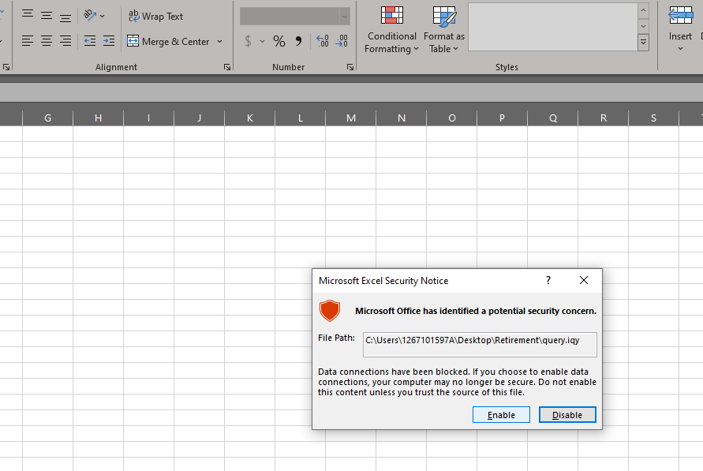
Click Enable and then use the filter drop down to find all the CAT A and CAT B individuals. You can also use the drop down to find bases and other identifiers.

